Slide 1


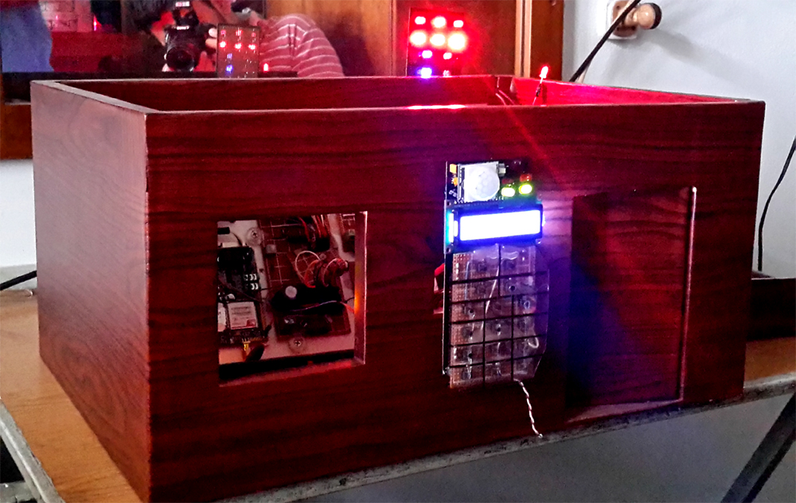
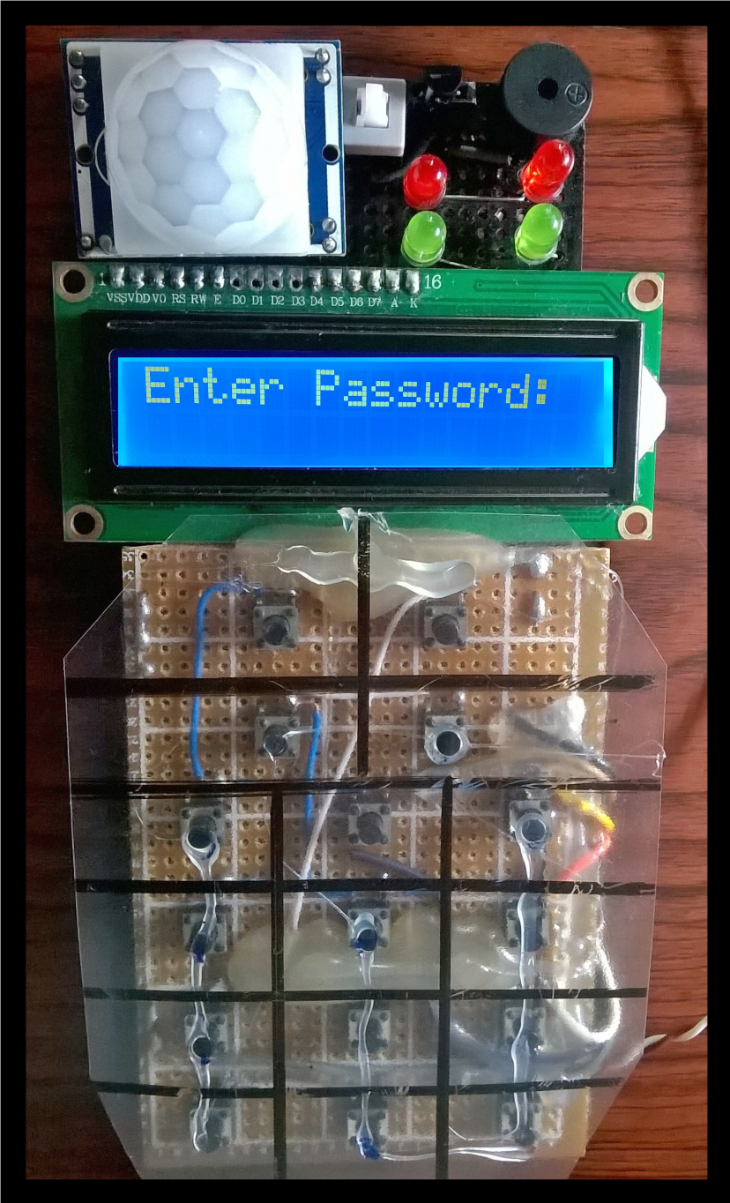
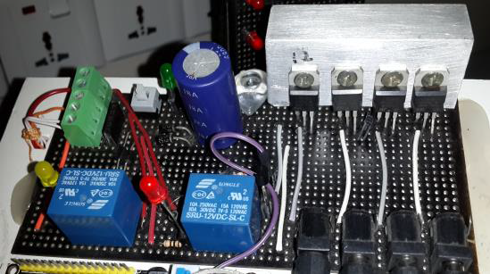
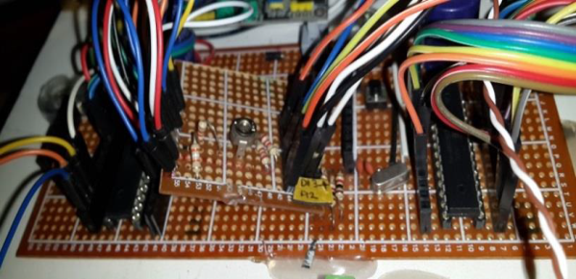
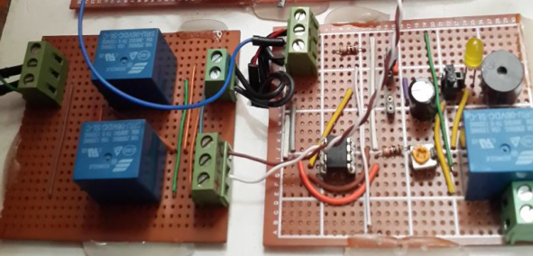
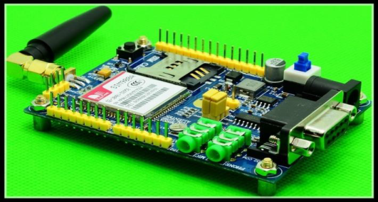
A SMART SECURITY SYSTEM
Asif Anwar, Fazle Elahi, Sayeedur Rahman
Advisor: Dr. Hasan U. Zaman
Overview
Features
Cost
Atmega 328p (Arduino compatible) microcontroller based project.
Hardware prototype of a market ready product.
Low cost and a highly reliable smart security system.
Easily extendable design for future modification.
Password protected door lock.
Various types of sensors along with motion sensors for advanced security.
Generates a text message to the owner when the property is breached by intruders.
Signals an alarm in case of an intrusion.
Controls your home from your cell phone.
SIM 900A GSM module 3000 BDT
Atmega328p Microcontroller *2 320 BDT
LCD Display (16*2) 230 BDT
PIR Motion sensor *2 320 BDT
Magnetic Sensor 220 BDT
IR Laser diode 55 BDT
4500mAh Rechargeable battery*2 600 BDT
Miscellaneous 1095 BDT
Total costs : 5840 BDT
System
Motivation
Conclusion
World is moving towards automation creating a high demand of such products.
Low cost reliable system required to fulfill the needs of general people.
A market Computable Product to make a commercial system.
The project was completed successfully exceeding initial target.
The Cost of the system has been reduced to almost half of that of the existing systems.
Uninterrupted power supply guarantees security 24/7.
Acknowledgement
Designs
Thanks to our supervisor Dr. Hasan Uz Zaman who is a prestigious faculty member of ECE department, NSU for guiding us with valuable advice and for keeping track of our project progress.
Designs
.
LCD and Keypad Module:
Password protected system
Controls everything by the push of a button.
Calls the owner via GSM network
Generates a text message when wrong password is entered
Automatically detects users when they are near the module.
Controls electromechanical door locks.
Arms and disarms the security system.
Power Management:
Uninterrupted power supply up to 8hr in case of load shedding.
Automatic switching from AC to battery backup.
Charges the battery automatically.
Four different output voltage
Microcontroller:
Serial communication between two Atmega 328p microcontrollers.
Independent reset button for troubleshooting.
Minimal cost design
Capacitor banks ensure uninterrupted power while switching from Ac to battery backup.
Motor driver and alarm circuit
Can control the clockwise and anticlockwise rotation of any type of dc motor
Can power any type of LED and buzzer and produce a alarm effect.
GSM Board
Programmed to call the owner at the push of a button.
Generates an SMS when a wrong password is entered.
Generates SMS in case of unauthorized entry.
Controls the whole system remotely via SMS
References
C How to Program by Paul Dietel & Harvey Dietel Fundamentals of electric circuits 4th edition by Alexander Sadiku
Electronic devices 9th edition by Thomas Floyd

